Slide 1

Workshop on Robotic Simulation
Robo Carnival 2023

Slide 2
Introduction to the software
Interface
Scene, navigation (Pan, rotate, zoom)
Placing basic objects (Move, rotate, scale)
Object properties (Static, Dynamic, Respondable, Non-respondable)
Model Browser – pick and place (Mobile robot, Stationary robot)
Scene Hierarchy
Scripts

Slide 3
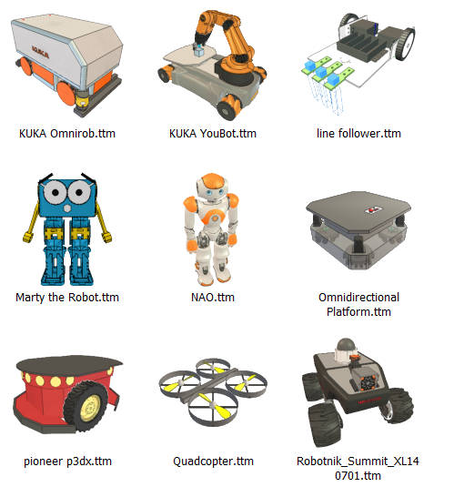
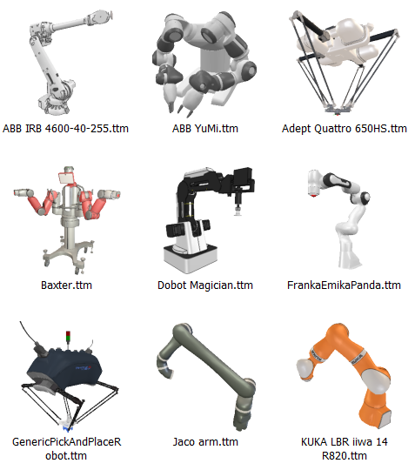
Types of Robots
Mobile Robot
Non-mobile Robot

Slide 4
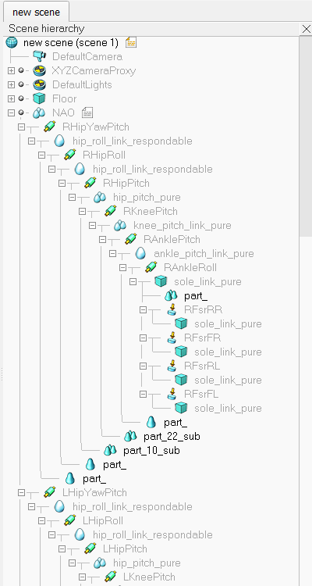
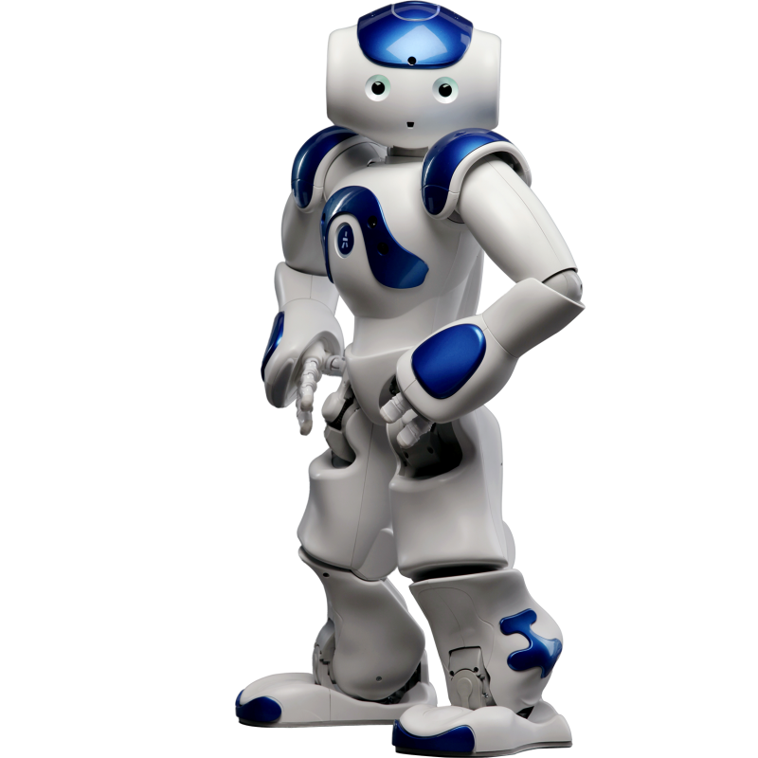
Robot Structure
Scene Hierarchy
Link
Joint

Slide 5
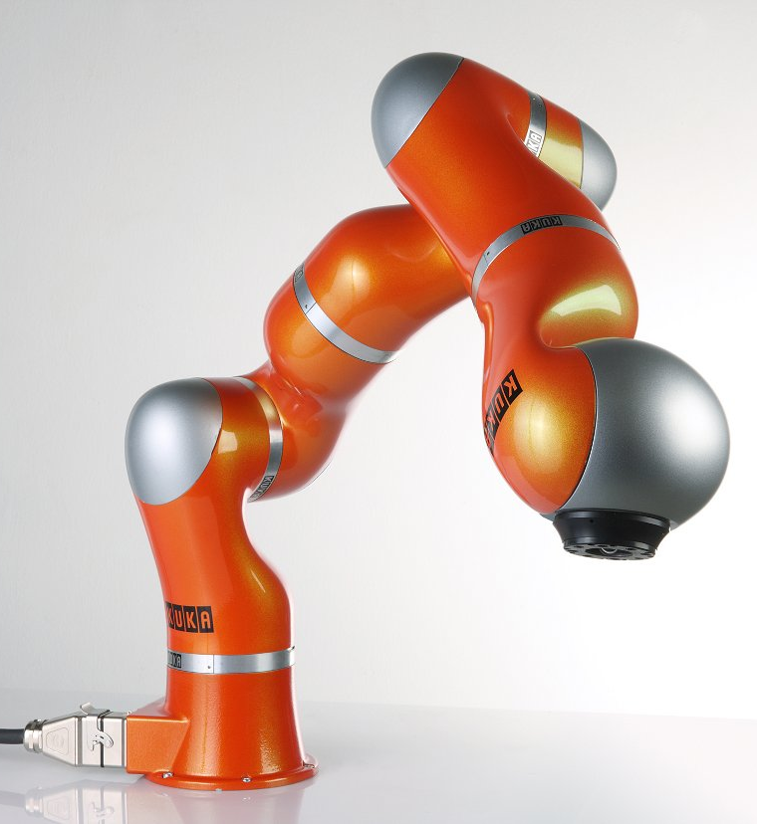
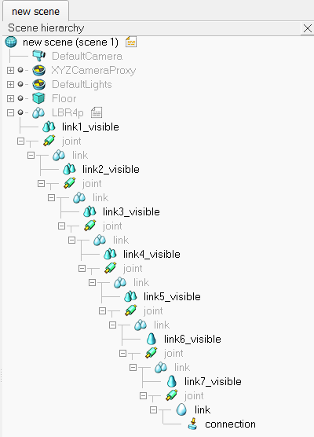
Robot Structure
Scene Hierarchy
Joint
Link

Slide 6
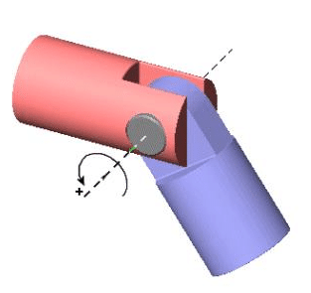
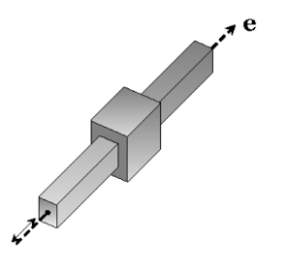
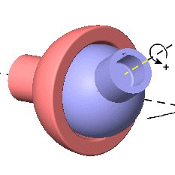
Robot Joints
Revolute Joint (Rotational- 1 Axis)
Prismatic Joint (Translational – 1 Axis)
Spherical Joint
(Rotational- 3 Axis)

Slide 7
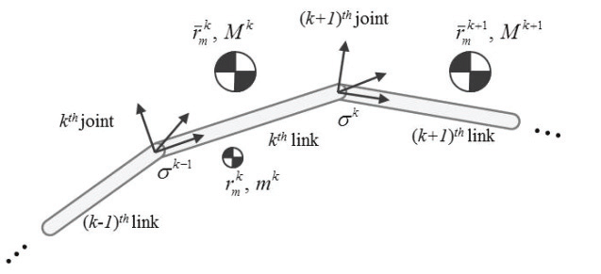
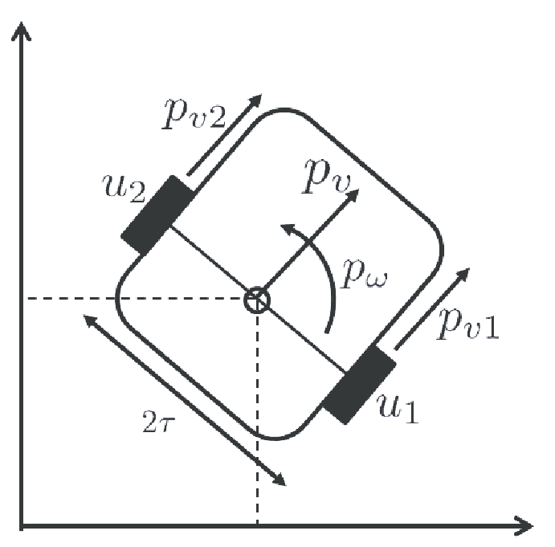
Actuators
Position Control
Velocity Control

Slide 8
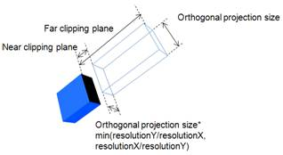
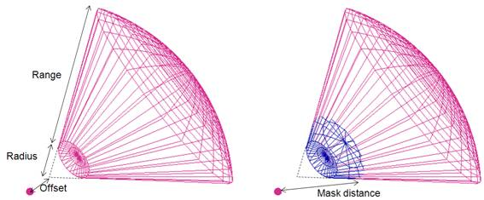
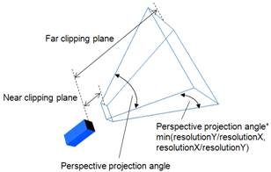
Sensors
Vision Sensor
Proximity/Distance Sensor
Orthographic
Perspective
Equivalent to Ultrasound/IR proximity

Slide 9
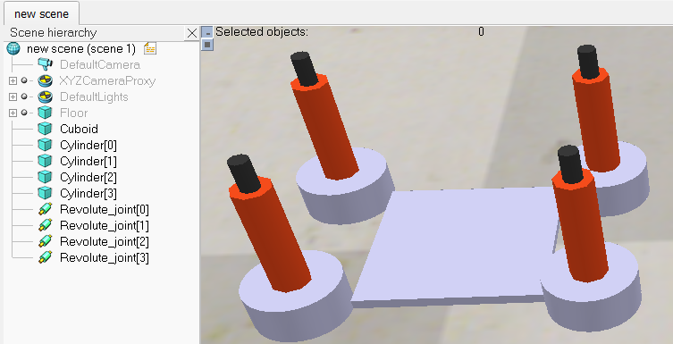
Line Following Robot Build
Body of the Robot (1 Cuboid)
Add > Primitive shape > Cuboid
Dimension (10cm x 10cm x 0.5cm)
Default unit is in meters
Wheels of the Robot (4 Cylinder)
Add > Primitive shape > Cylinder
Dimension (5cm x 2cm)
Motors of the Robot (4 Joints)
Add > Joint > Revolute

Slide 10
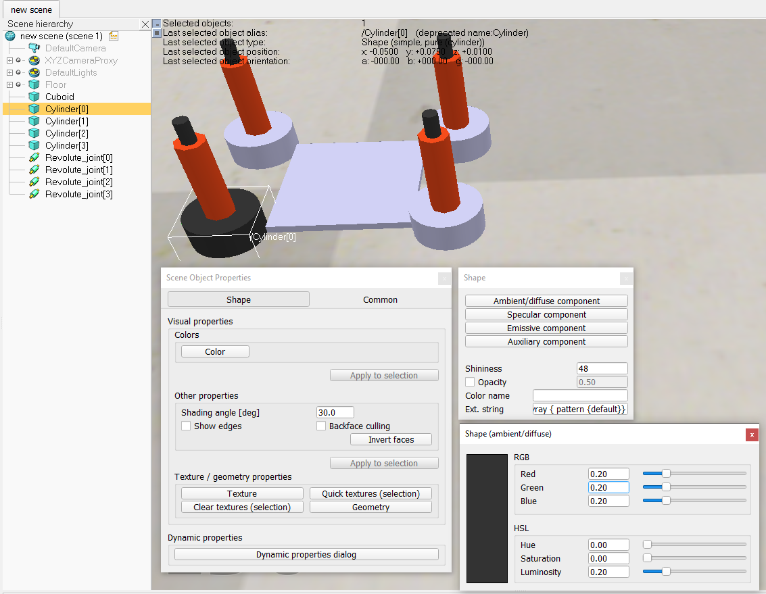
Colors
Double click cuboid icon
Object Properties > Color
Shape > Ambient/diffuse
Components
Adjust color parameters

Slide 11
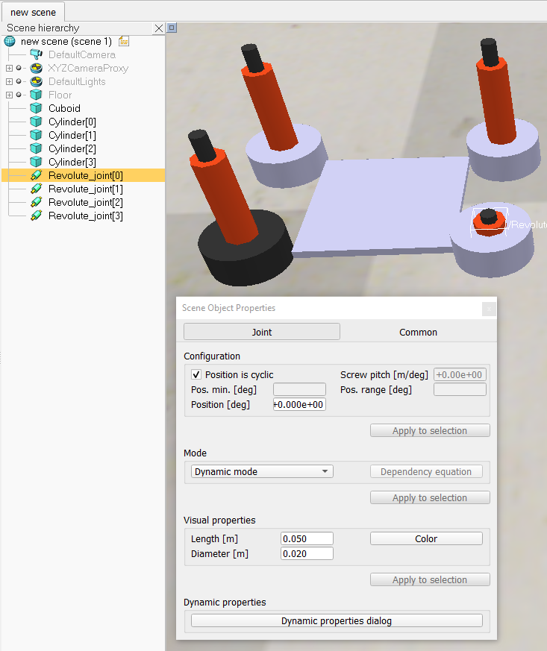
Joints
Double click joint icon
Object Properties > Visual Properties
Adjust the values
This changes appearance only,
no effect on joint behavior

Slide 12
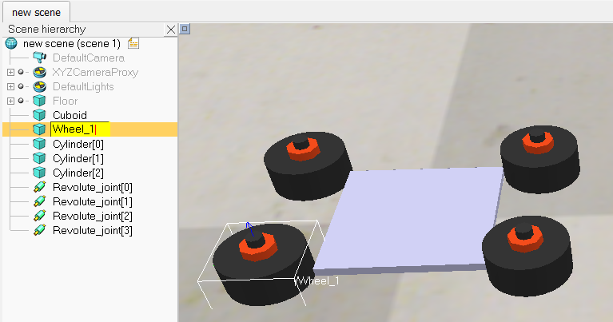
Renaming
Double click on name of object
Set appropriate name
Hit enter to set name

Slide 13
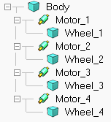
Link-Joint-Link
Drag and drop objects to set the appropriate object hierarchy.
Body should be first link
Joints are child of body
Each wheel is child of a joint

Slide 14
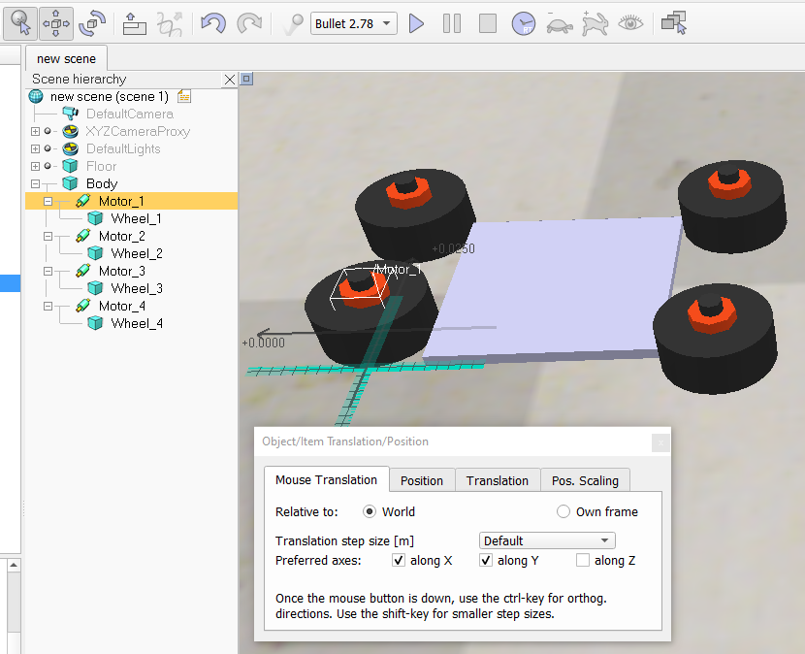
Moving Objects
Select a joint/object
Click on translation icon
With mouse translation tab active,
drag the object around
Child objects will move with parent

Slide 15
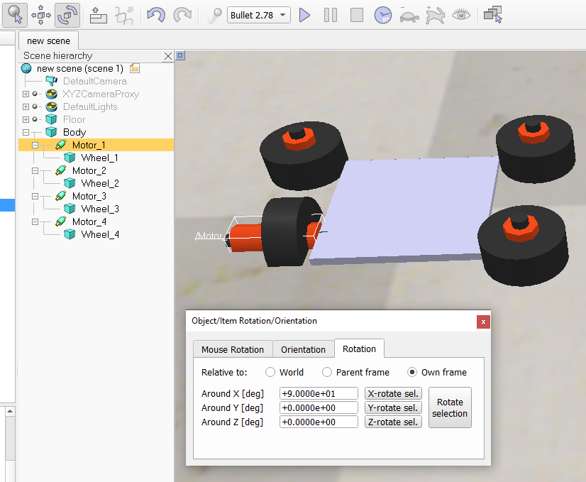
Rotating Objects
Select a joint/object
Click on rotation icon
Go to Rotation tab
Select Own frame
Around X [deg] > 90
Click X-rotate sel

Slide 16
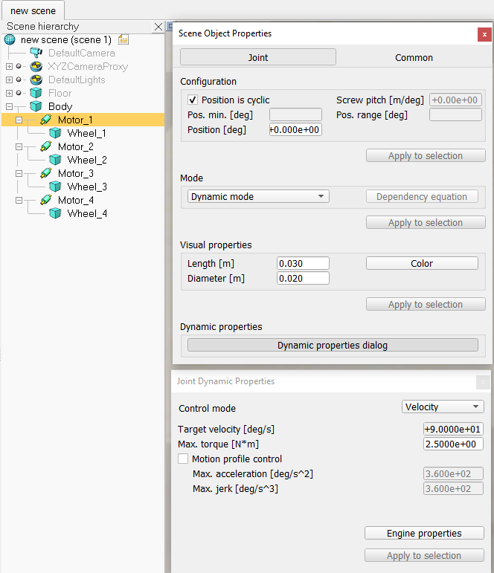
Enable Motor
Double click joint icon
Dynamic properties dialog
Control mode > Velocity
Set velocity to 0

Slide 17
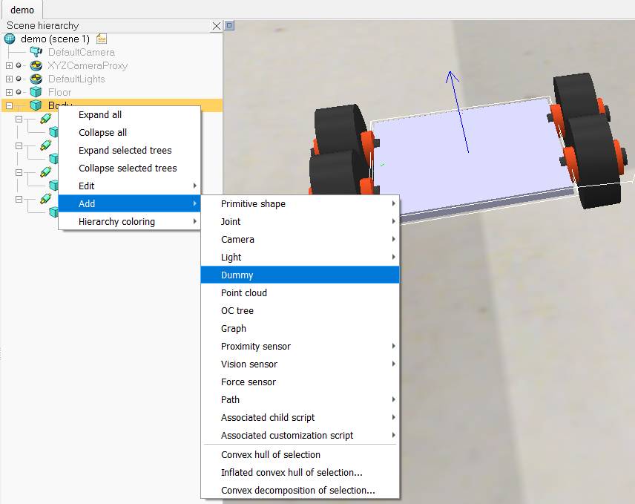
Adding Sensors
Create a new dummy object and make it a child of the robot body
Rename the dummy to “SensorArray”, we will place 5 vision sensors under this.

Slide 18
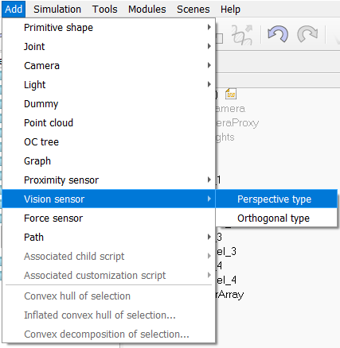
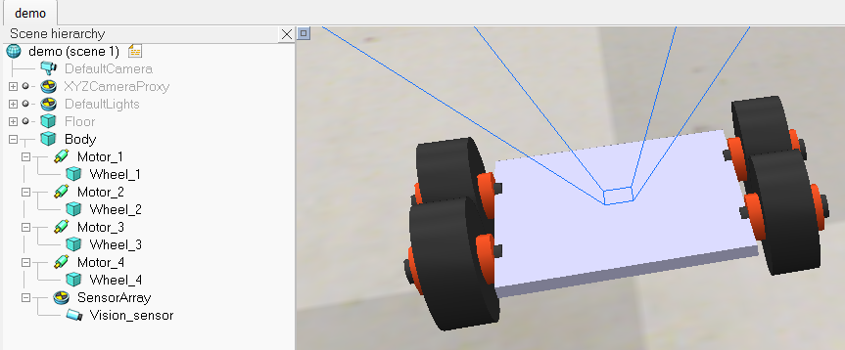
Vision Sensors
Add > Vision sensor > Perspective type
A vision sensor object will appear on screen
Place this object as a child of the SensorArray

Slide 19
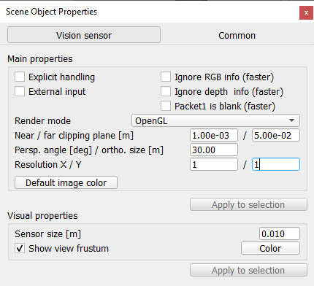
Sensor Properties
Double click on the camera icon
The vision sensor can act as a regular camera, which we will observe later. For now we wish to use it similar to an infrared sensor used in line follower robots.
Change the following parameters:
Near/far clipping plane: 0.001-0.05 (1mm-5cm)
Persp. Angle: 30
Resolution: 1x1

Slide 20
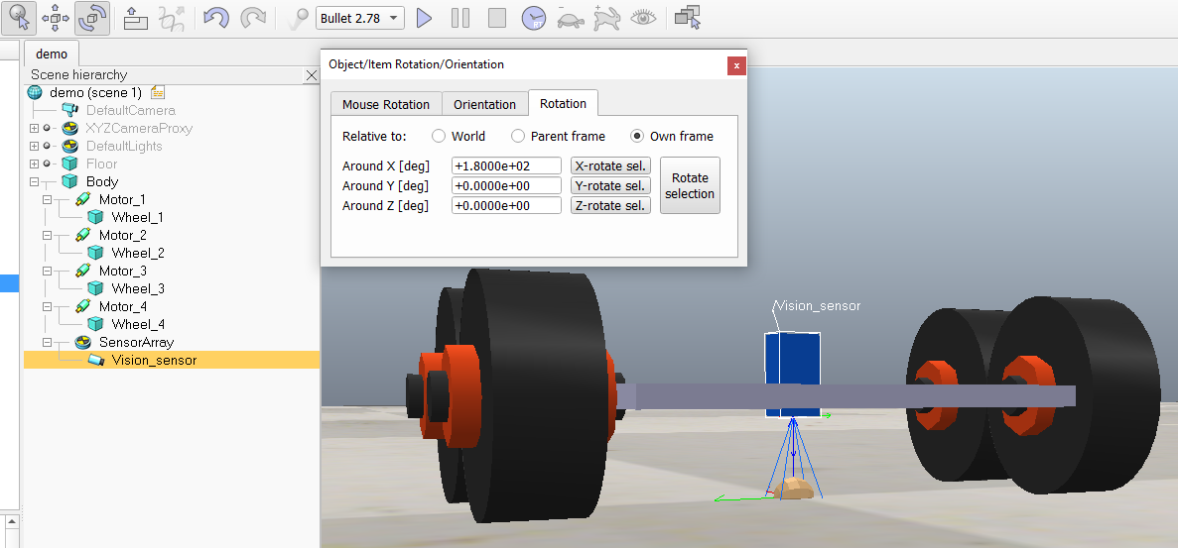
Sensor Orientation
Since the sensor is facing upwards, we need to rotate it 180 degrees along wither X/Y axis to face downwards

Slide 21
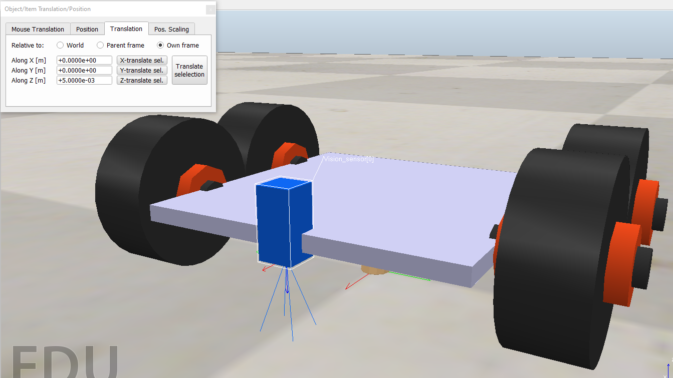
Sensor Position
Bring the vision sensor to the forward of the robot using the translation tool

Slide 22
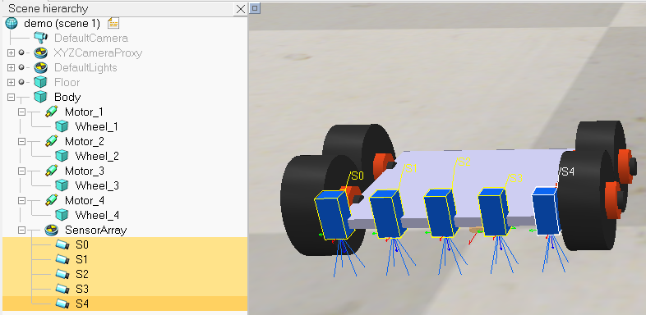
Sensor Array
Copy the sensor and paste it 4 times to create duplicates of the sensor. Place them in a linear fashion under the SensorArray dummy object. Rename the sensors in the following manner.

Slide 23
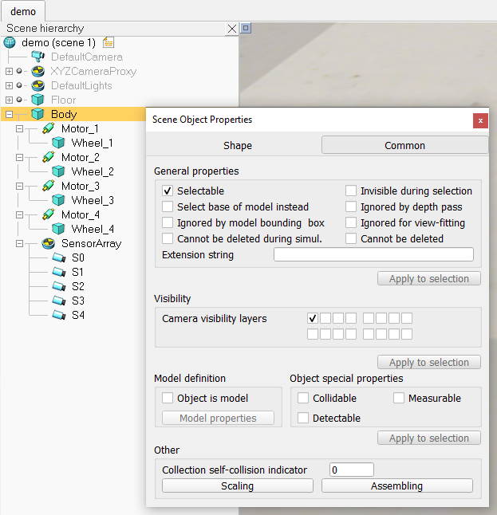
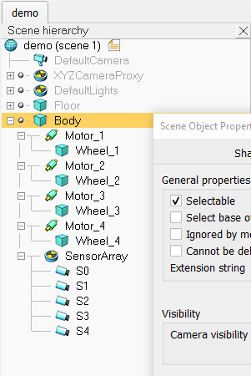
Finalizing Robot Model
Double click on the robot body icon
Go to the common tab
Select object is model. (A circular icon appears in the scene hierarchy)
Now the robot can be copied and pasted in the scene multiple times.

Slide 24
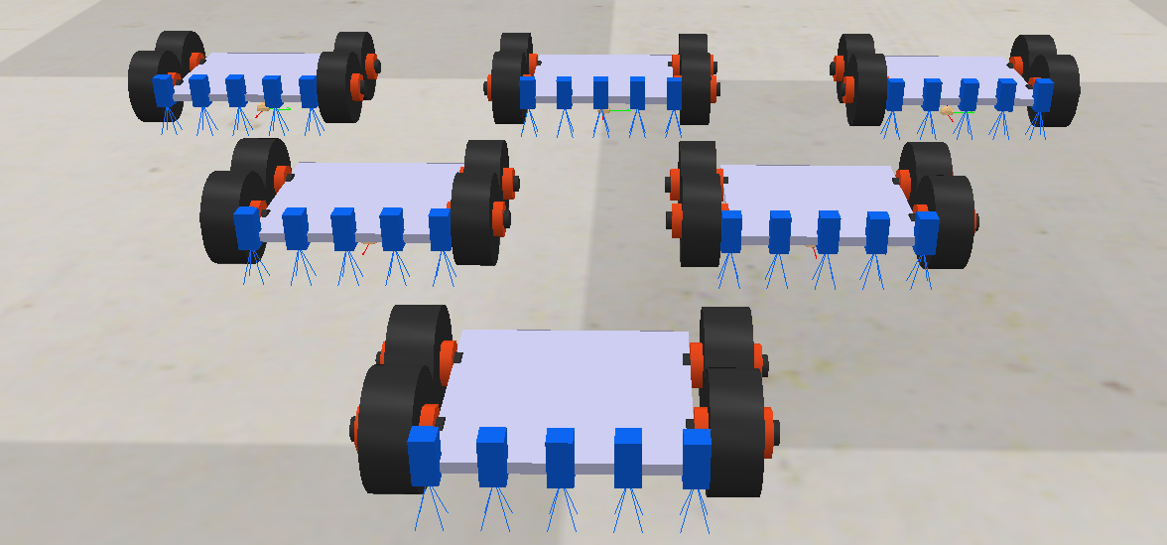
Congratulations on Making Your First Robot Simulation Model !

